Slide 1
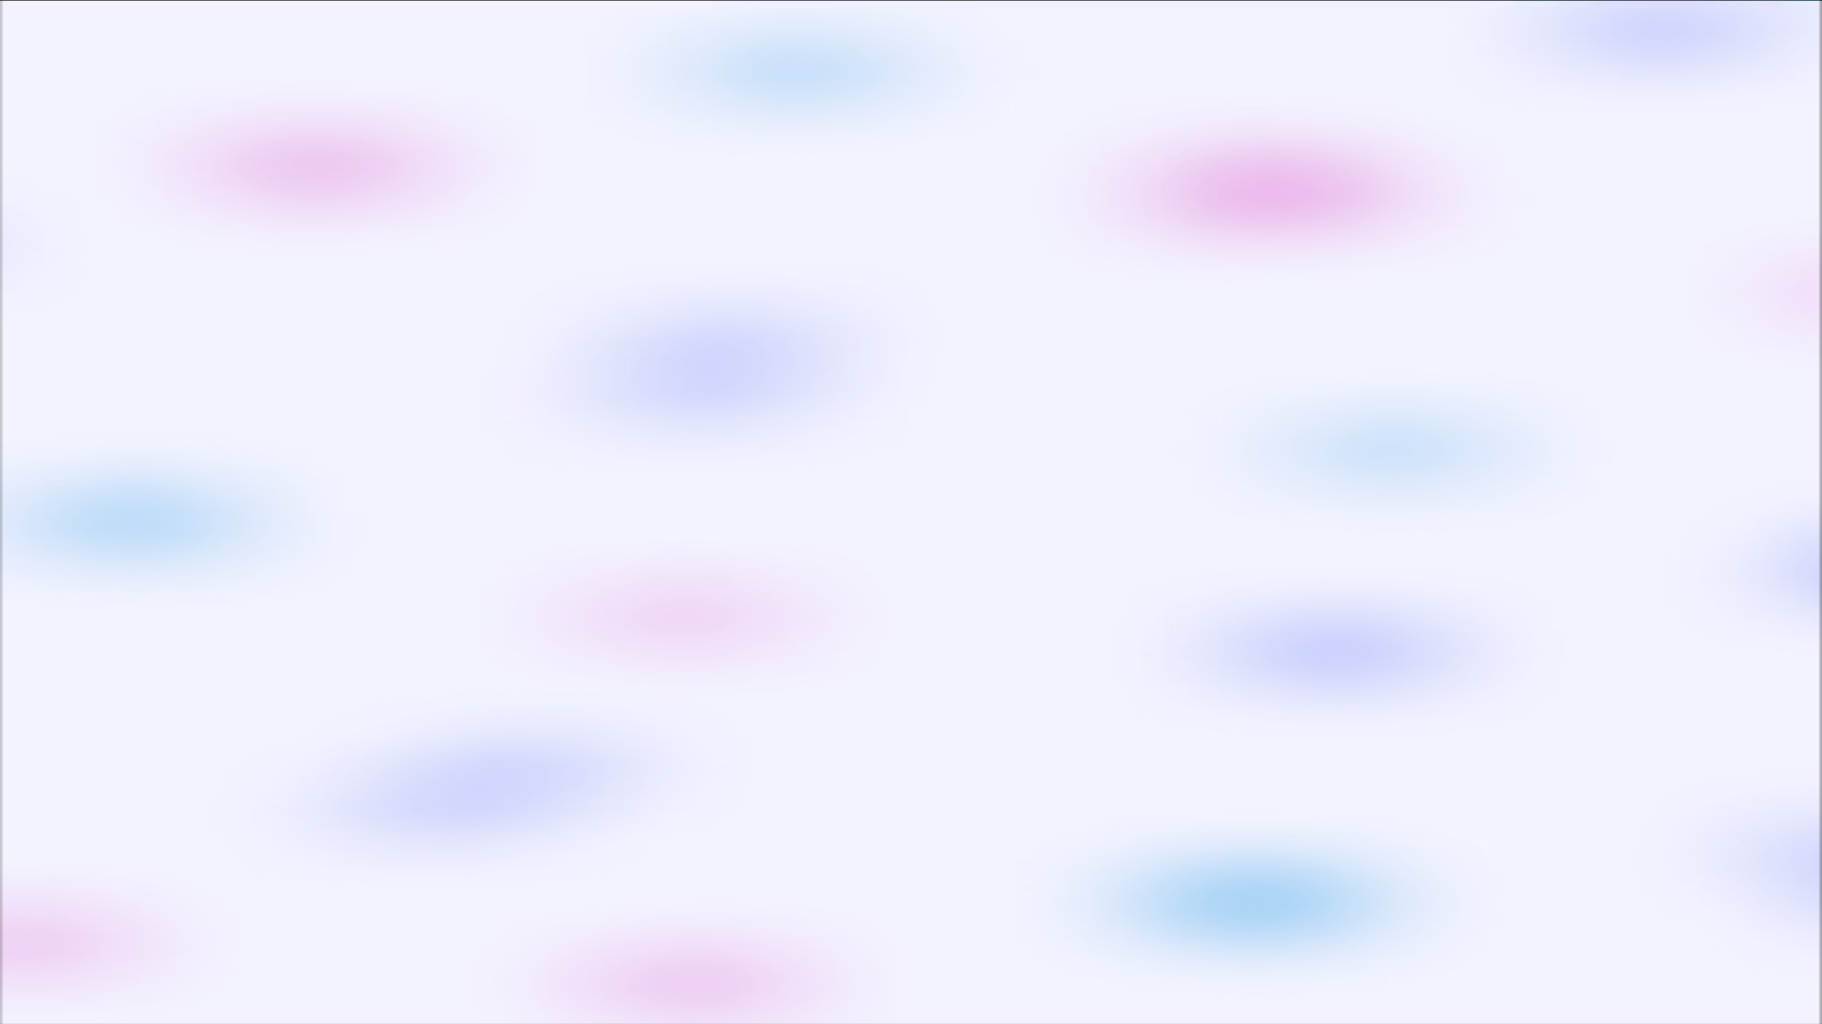
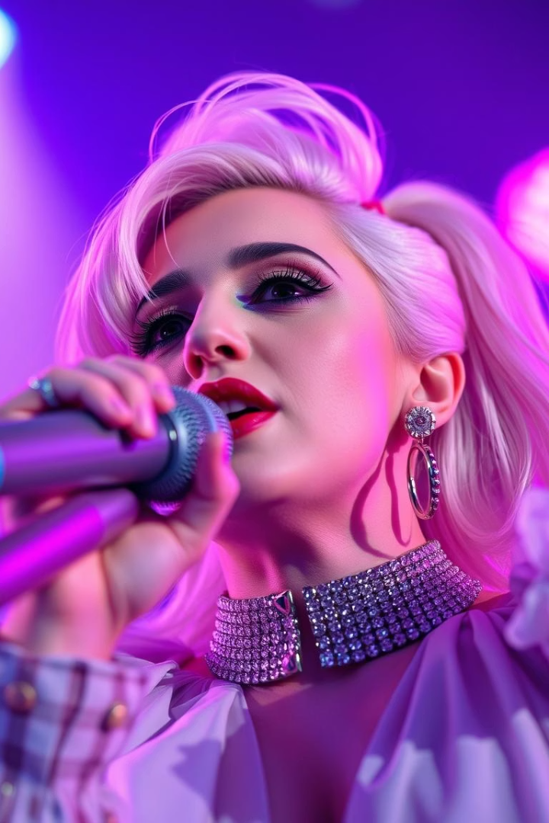
Zipf's Law in Song Lyrics: A Case Study on Lady Gaga
Presented by Team Hackdev:
Krit Garg - krit.garg01@adypu.edu.in
Deepak Pathik - deepak.pathik@adypu.edu.in
Harsh Hirawat - harsh.hirawat@adypu.edu.in
Harshit Singh - harshit.singh@adypu.edu.in
Notes:
1

Slide 2

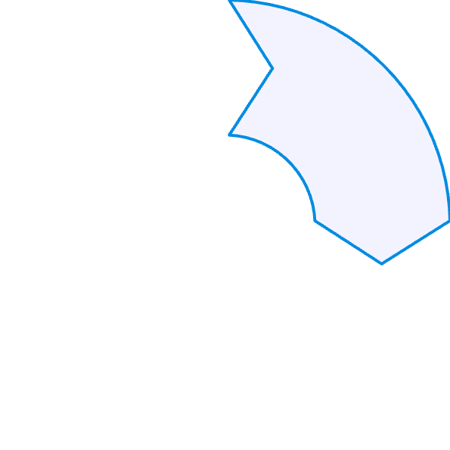
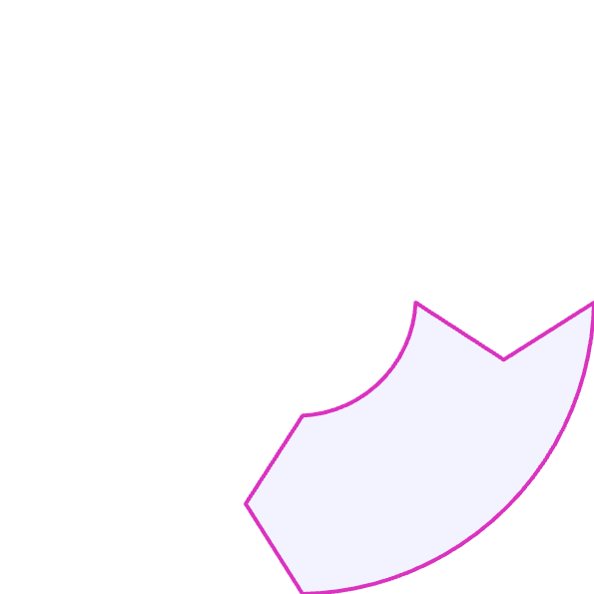

Introduction to Zipf's Law
Zipf's Law Defined
Mathematical Formula
The frequency of a word is inversely proportional to its rank in a given text.
1
The frequency of the word ranked r is given by: f(r) ∝ 1/r.
2
Applications
Project Objective
4
3
This phenomenon is observed in natural languages and various other contexts.
To analyze Lady Gaga's song lyrics through the lens of Zipf's Law.
Notes:
2

Slide 3
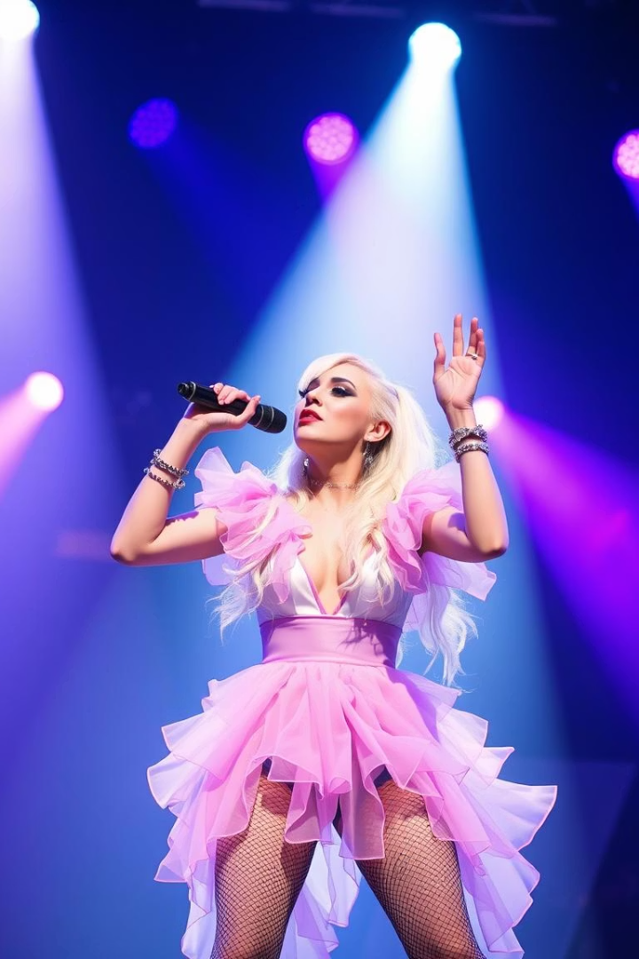





Dataset Overview
Source
Word Counts
Songs Analyzed
Dataset: LadyGaga.csv
136,516 total words
395 songs included
Unique Words
Attributes
4,975 distinct words
Title
Artist
Album
Year
Date
Lyric
Notes:
3

Slide 4

Data Preprocessing
Normalize
Tokenize
Lowercase all lyrics for uniformity
Split text into individual words
Clean
Aggregate
Remove empty and non-alphabetic entries
Combine lyrics into one corpus
Rank & Count
Calculate word frequencies and ranks
Notes:
4

Slide 5

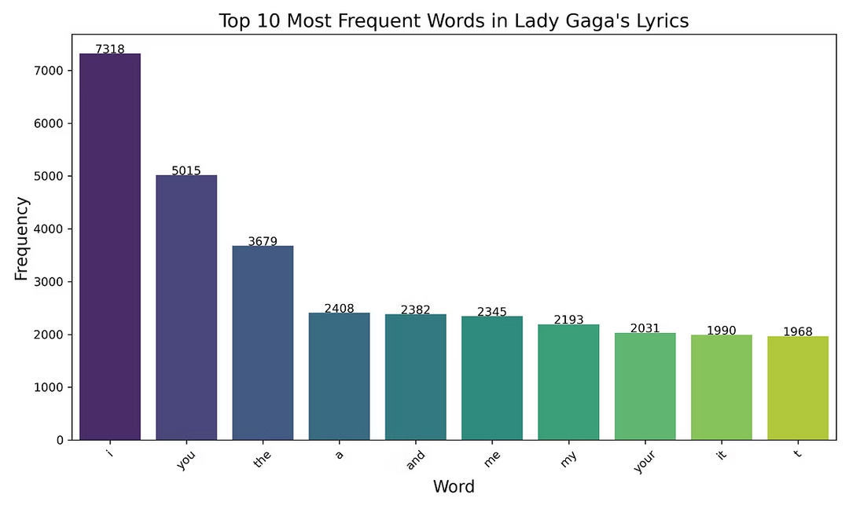
Frequency Analysis
Most Frequent Words
'I', 'you', 'love', 'like'
Common pronouns & verbs dominate
Frequency Distribution
Top words occur thousands of times
Significance
Reflects thematic and stylistic choices
Notes:
5

Slide 6

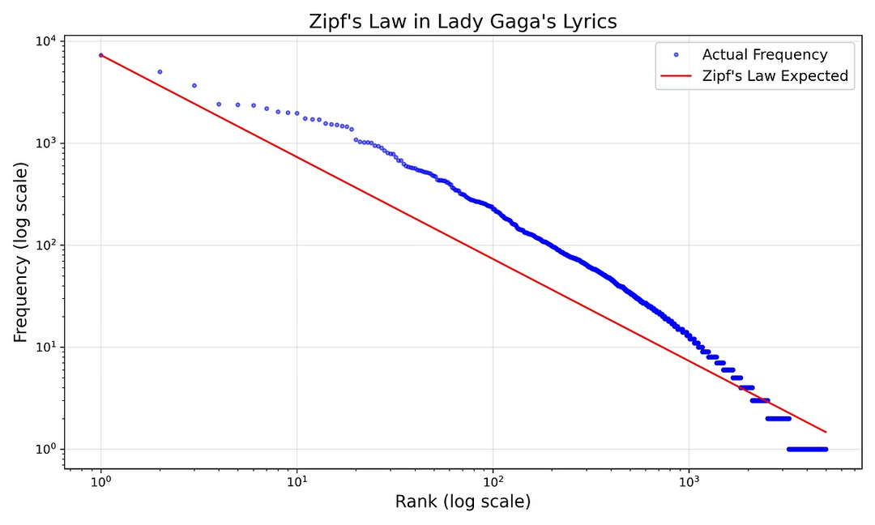
Zipf's Law Visualization
This log-log plot compares the actual word frequencies found in Lady Gaga's song lyrics with the theoretical expectations predicted by Zipf's Law. The plot visually demonstrates how word usage follows an inverse relationship between a word's rank and its frequency of occurrence. By observing the alignment between the empirical data and the Zipfian curve, we can better understand the linguistic patterns and the natural distribution of words in her lyrics.
Notes:
6

Slide 7






Key Observations
Zipf's Law Fit
Lyrics closely follow Zipf's distribution overall
Dominant Words
'I', 'you', and 'love' occur most frequently
Artistic Influence
Repetition skews distribution of rare words
Pop Lyric Patterns
Lady Gaga's vocabulary is typical of pop music
Thematic Words
Certain themes appear more frequently than usual
Notes:
7

Slide 8
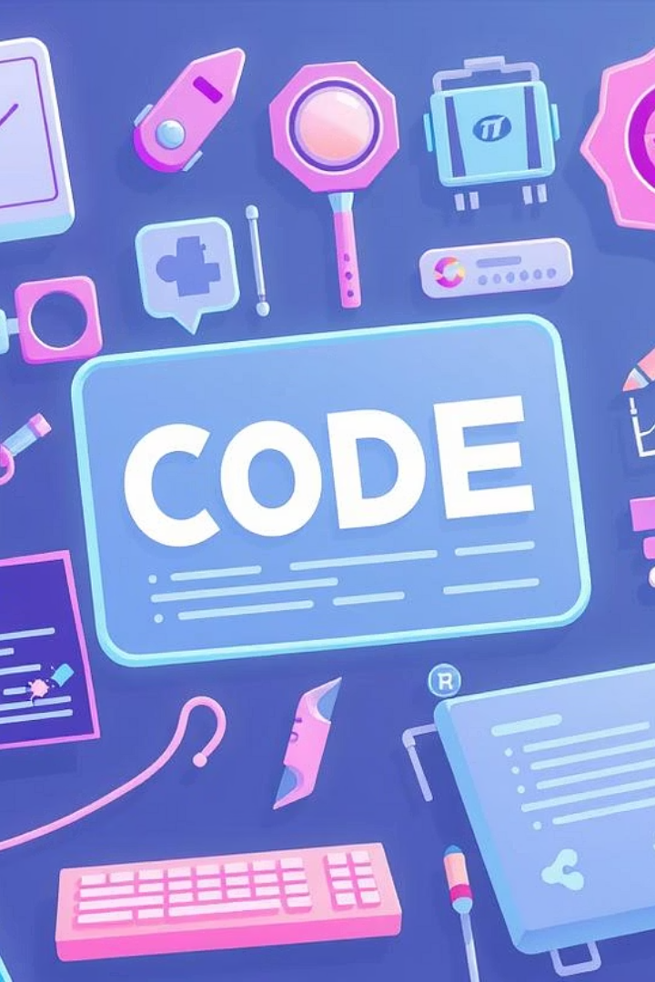




Tools and Technologies
Python
Primary programming language for analysis
pandas
Efficient data manipulation and handling
matplotlib & seaborn
Used for creating visualizations and plots
Other Libraries
collections.Counter for frequency counting
Regular Expressions for text cleaning
Notes:
8

Slide 9
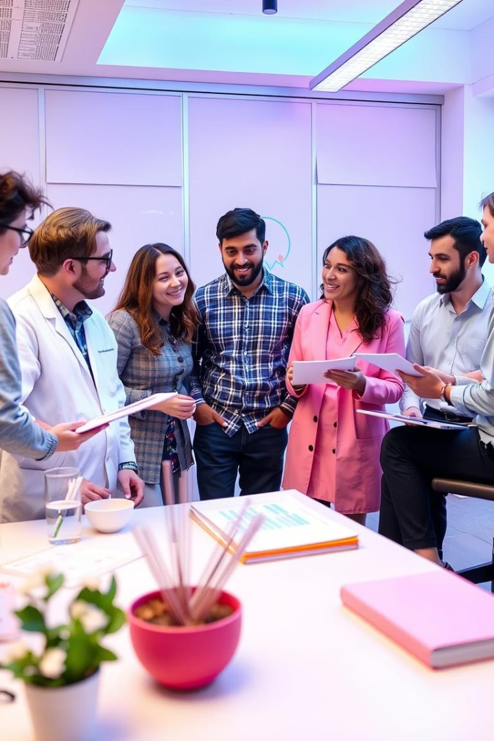




Individual Contributions
Harsh Hirawat
Preprocessing, tokenization, frequency analysis
Deepak Pathik
Zipf's Law computations, log-log visualization
Harshit Singh
Visualization, data insights, report writing
Krit Garg
Presentation design, content structure, review
Notes:
9

Slide 10
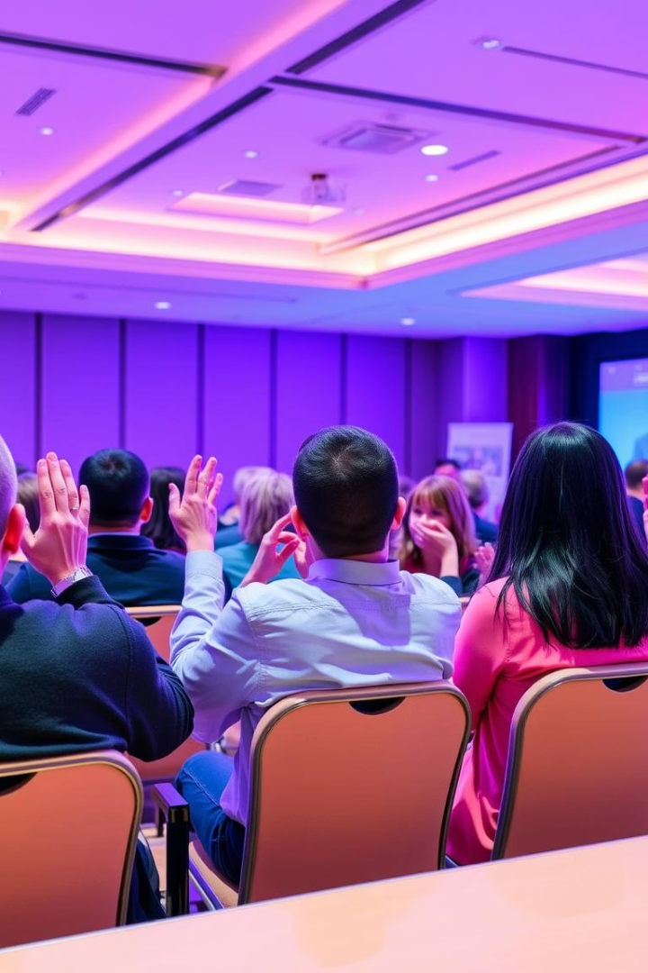
Thank You!
We appreciate your attention and interest.
Notes:
10

